Slide 1
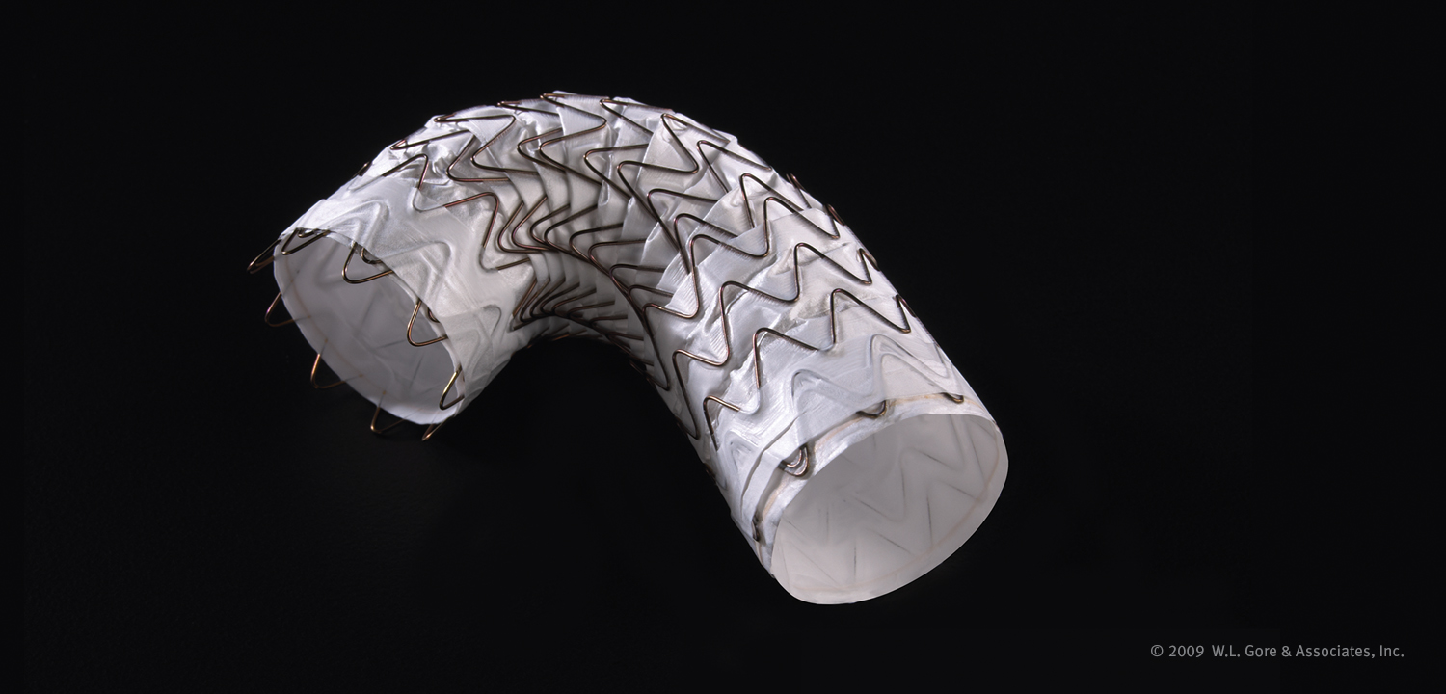

Slide 2
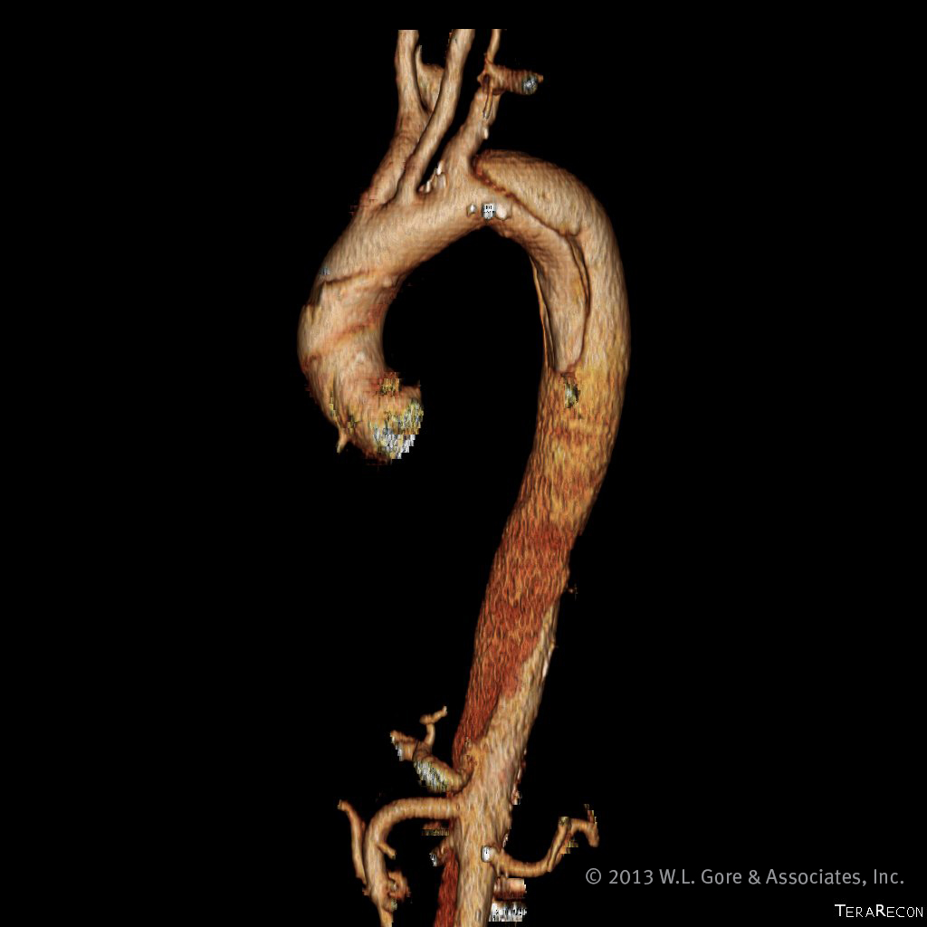
Indications for use
Indications within the United States
The GORE® TAG® Thoracic Endoprosthesis is intended for endovascular repair of all lesions of the descending thoracic aorta, including:
Isolated lesions in patients who have appropriate
anatomy, including:
Adequate iliac / femoral access
Aortic inner diameter in the range of 16–42 mm
≥ 20 mm non-aneurysmal aorta proximal and distal to
the lesion
Type B dissections in patients who have appropriate
anatomy, including:
Adequate iliac / femoral access
≥ 20 mm landing zone proximal to the primary entry tear; proximal extent of the landing zone must not be dissected
Diameter at proximal extent of proximal landing zone in the range of 16–42 mm
Contraindications within the United States
Patients with known sensitivities or allergies to the device materials
Patients who have a condition that threatens to infect the graft

Slide 3
Indications for use
Indications under CE Mark in Europe
The GORE® TAG® Thoracic Endoprosthesis is intended for endovascular repair of all lesions of the descending thoracic aorta.
Contraindications under CE Mark in Europe
Patients with known sensitivities or allergies to the device materials
Patients with a systemic infection who may be at increased risk of endovascular graft infection

Slide 4
Table of contents
The science behind the Conformable
GORE® TAG® Thoracic Endoprosthesis
Device attributes
Partially uncovered stent
Radial force
Oversizing window
Now FDA approved for dissection
Clinical studies
Treatment considerations
Features and benefits
Required ancillary devices
Summary

Slide 5
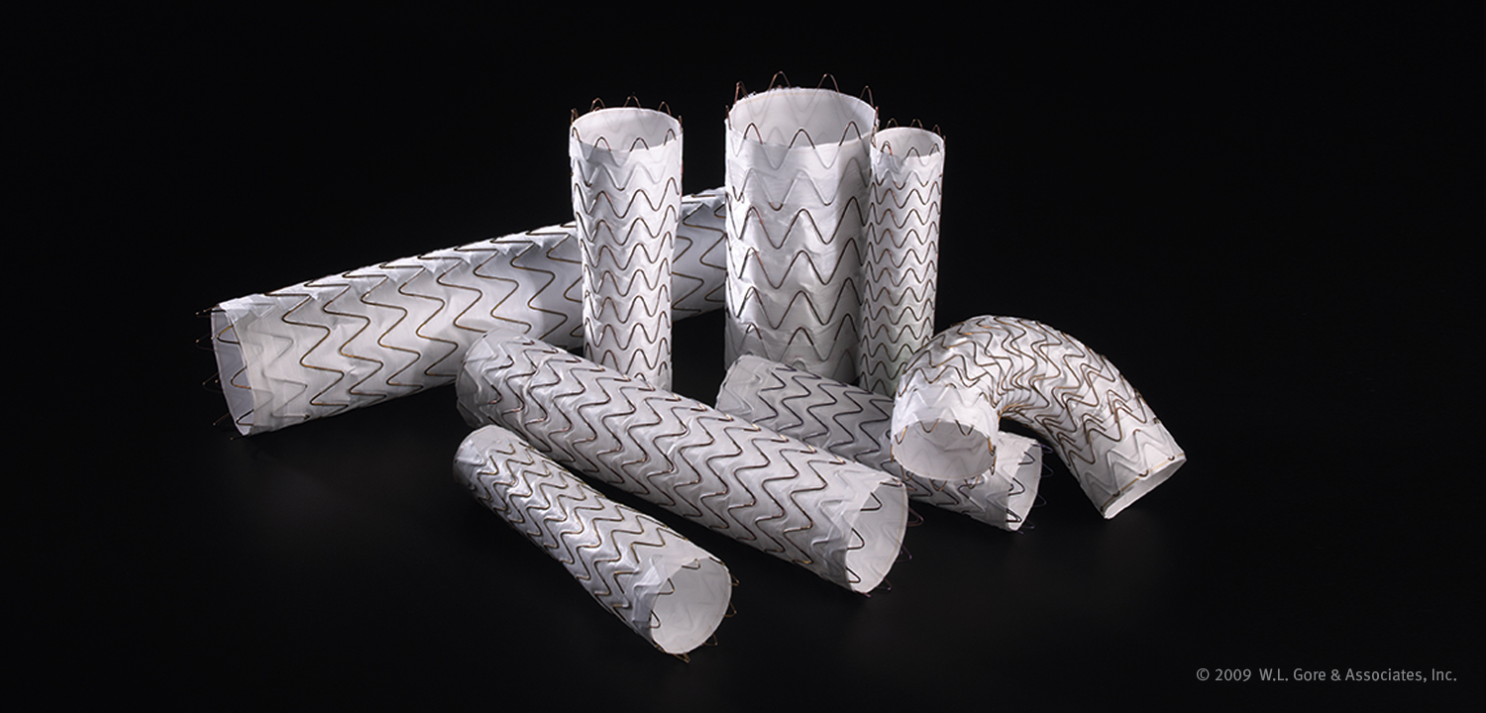
The science behind the Conformable
GORE® TAG® Thoracic Endoprosthesis

Slide 6
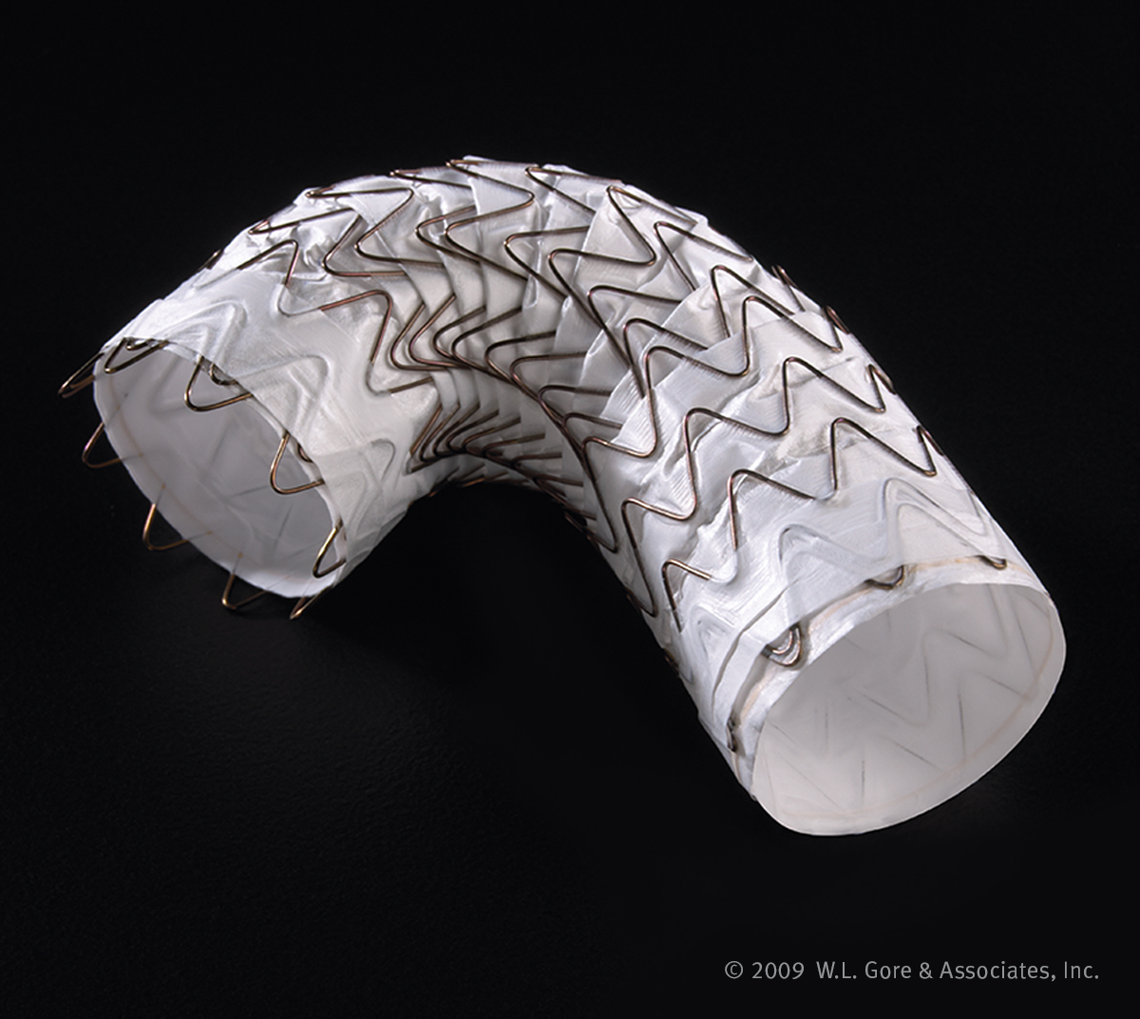
Extensive research behind the design
Design input from the GORE® TAG® Thoracic Endoprosthesis
Maintain the established performance and durability of the GORE® TAG® Device
Research to support the enhanced conformable design
Peak blood flow velocity in the thoracic aorta varies dramatically with patient age
Aortic diameters shown to increase with patient age
Need for a conformable thoracic endograft to meet a broad range of anatomies

Slide 7
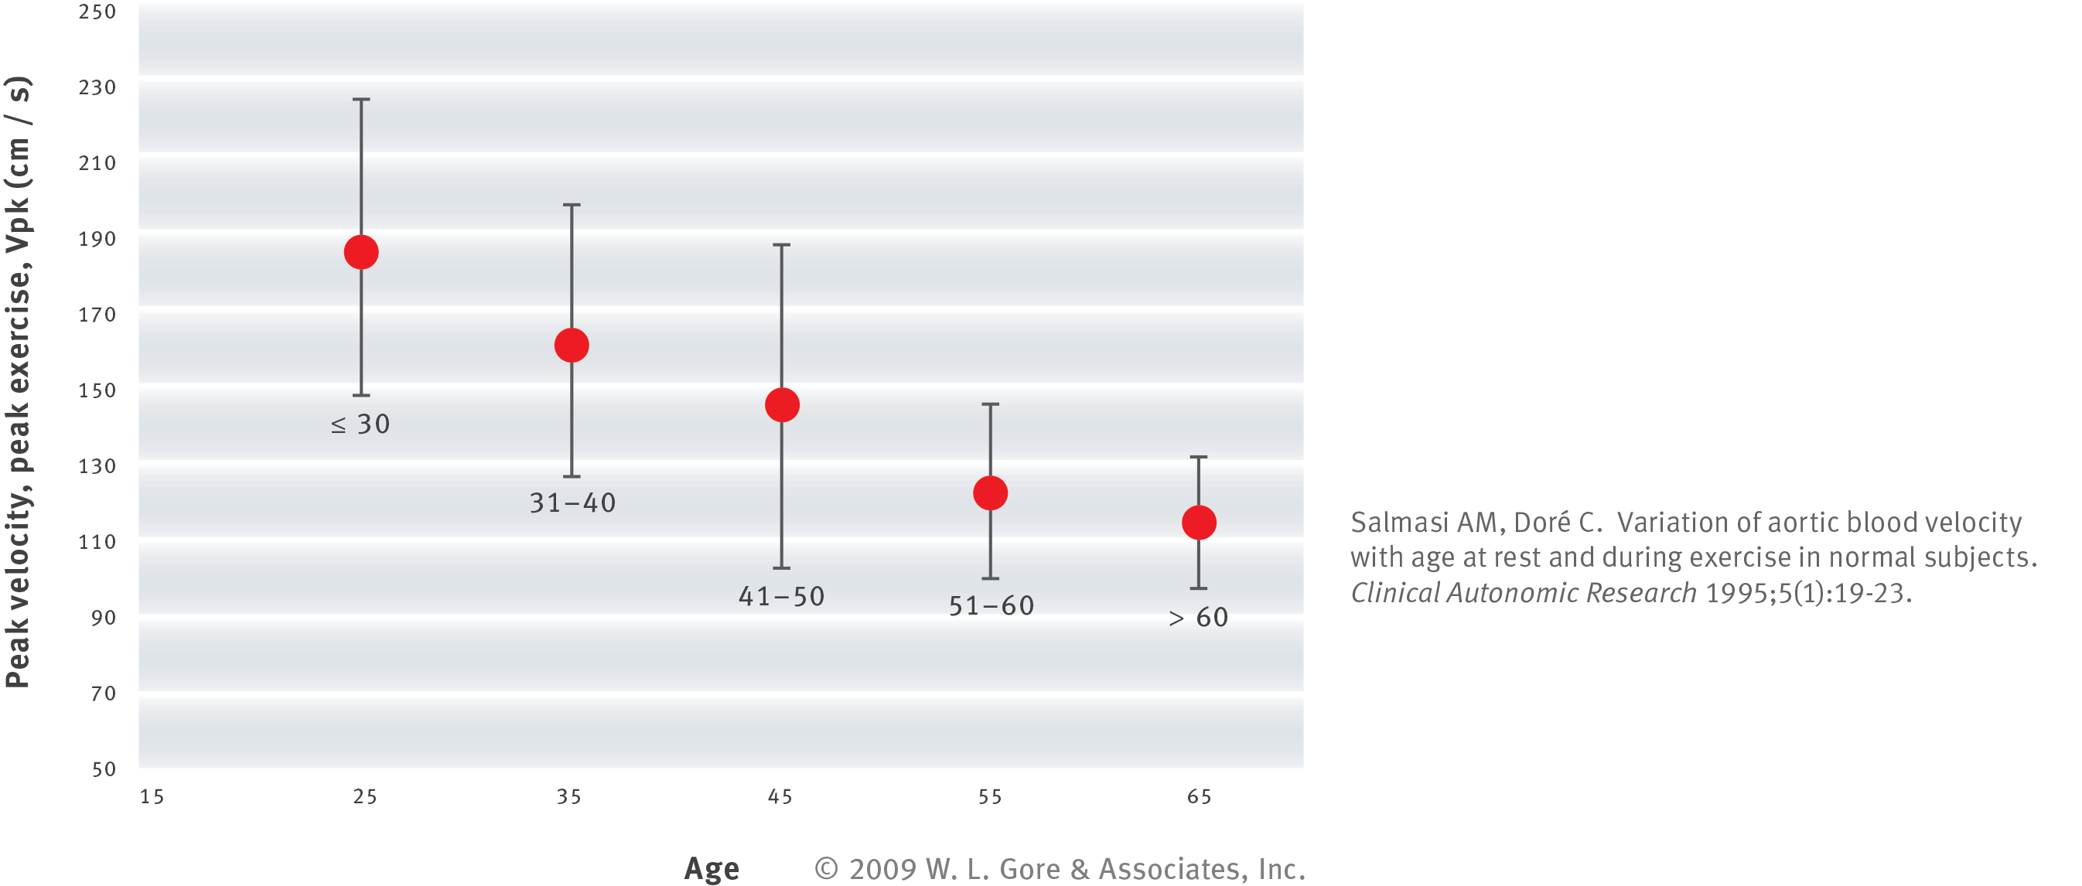
Peak blood flow velocity in the thoracic aorta
varies dramatically with patient age
Physiologic research studying the peak blood flow velocity in the thoracic aorta helped Gore understand the need for a thoracic endograft to optimize wall apposition and radial force over a wide range of aortic flow velocities
Younger patients can have a peak blood flow velocity that is twice that of an older patient

Slide 8
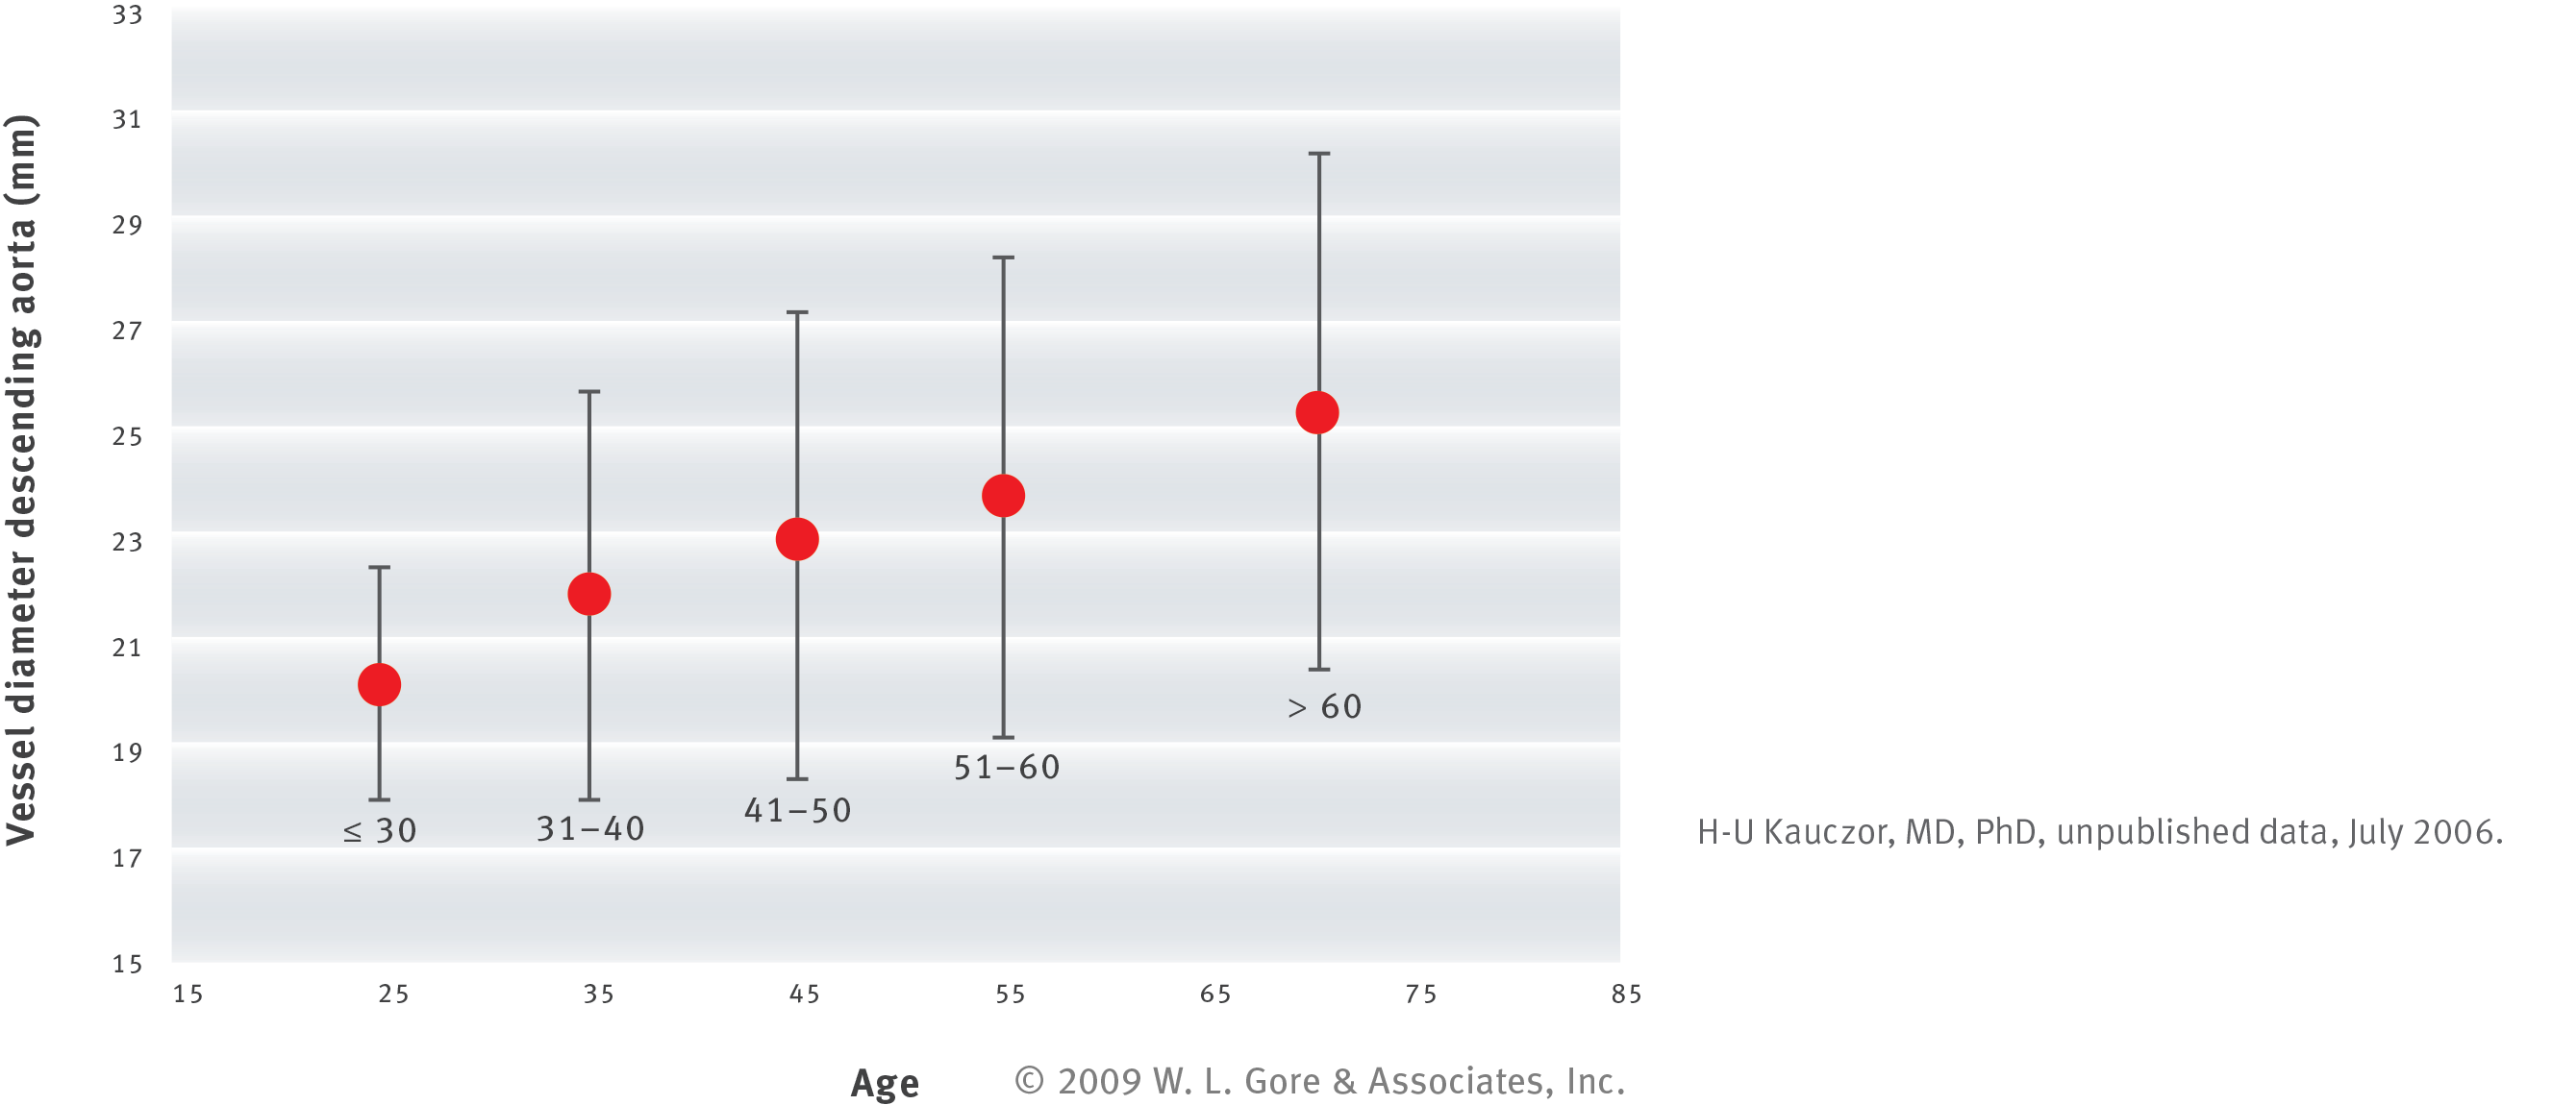
Aortic diameters shown to increase with patient age
Anatomical research studying aortic diameters showed that mean thoracic vessel diameter increased with patient age.

Slide 9
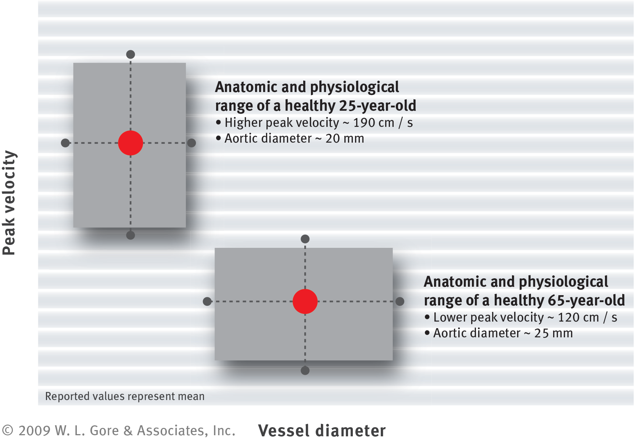
Need for a conformable thoracic endograft
to meet a broad range of anatomies
Understanding the peak velocity and aortic diameter range within each age group
provided important design inputs.

Slide 10
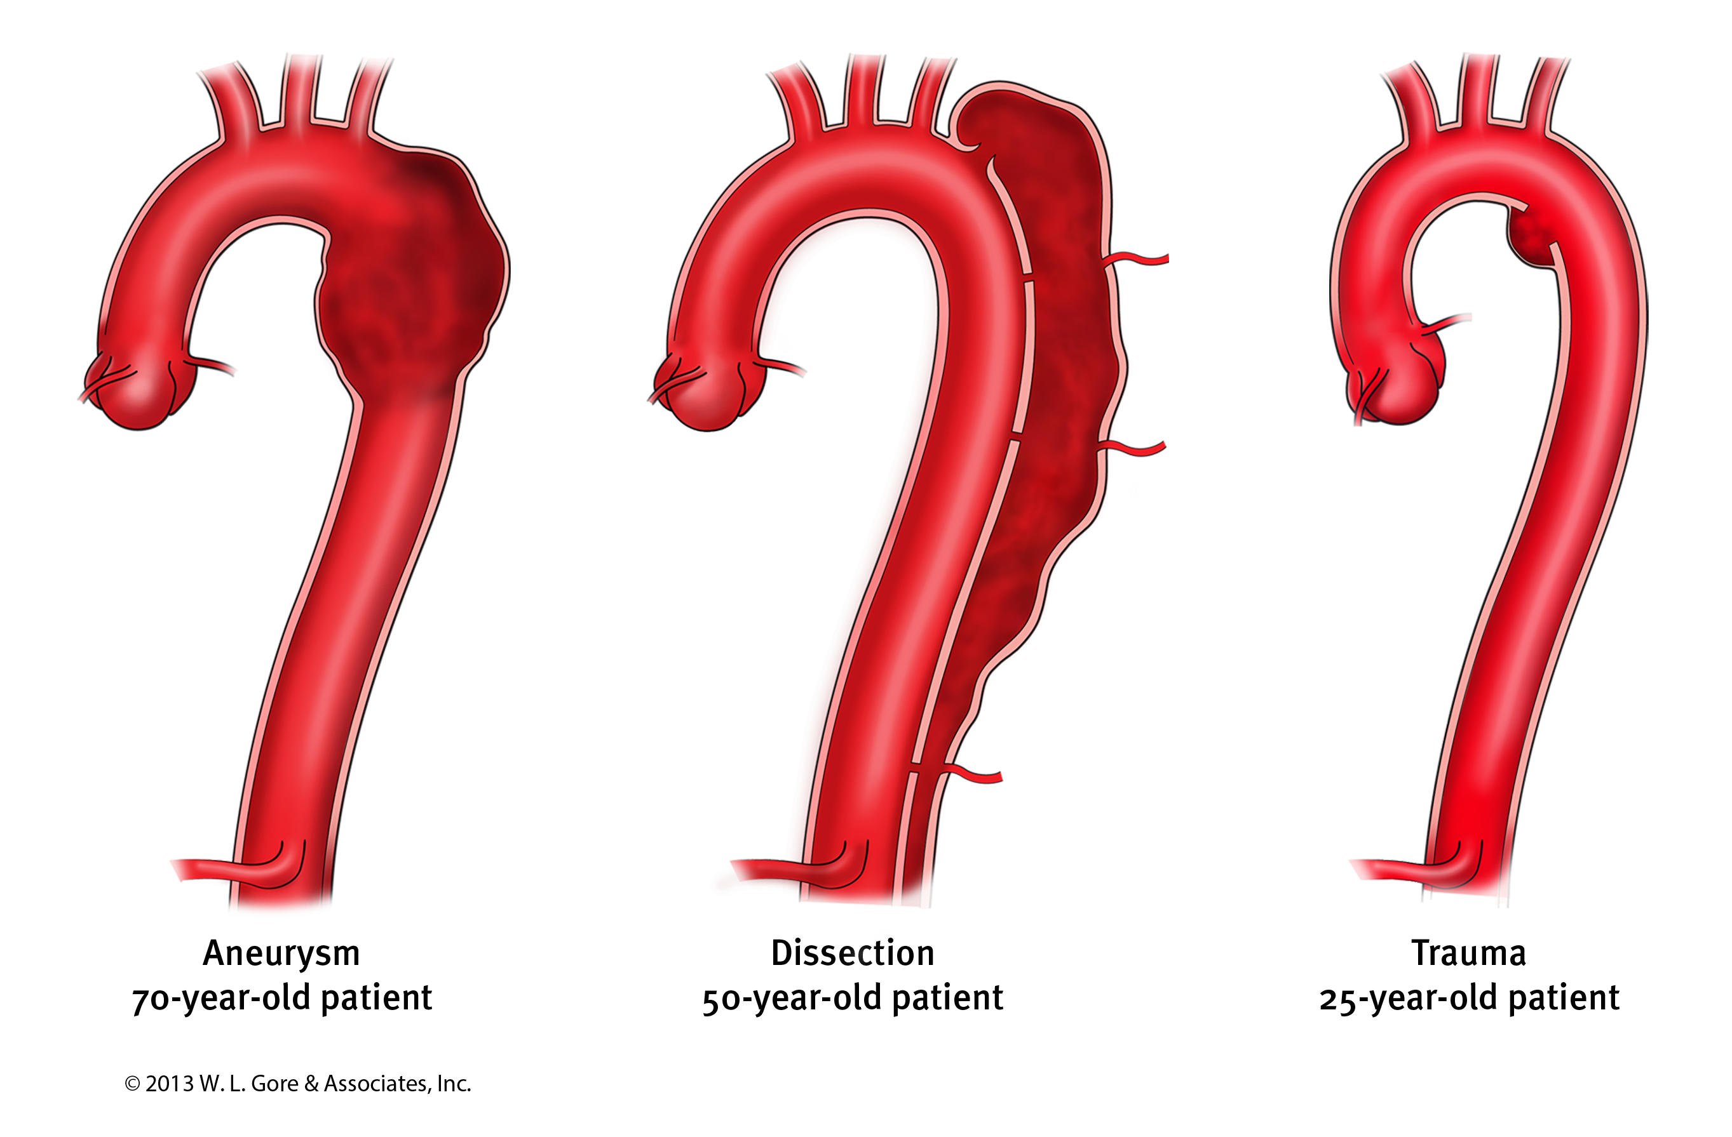
Extensive clinical research to
understand various thoracic etiologies
We continue our commitment to clinical research and have incorporated data from various studies including the TAG 04-01 High Risk Study (Complex Pathologies of the Descending Thoracic Aorta) into the design process for the device.

Slide 11
Indicated for all lesions of the
Descending Thoracic Aorta (DTA)
We worked with FDA to conduct three clinical trials to study the use of the Conformable GORE® TAG® Device in aneurysms, traumatic transections, and acute complicated Type B dissections:
TAG 08-03 Aneurysm Study led to FDA approval for DTA aneurysms in August 2011
TAG 08-02 Traumatic Transection Study led to FDA approval for isolated lesions of the DTA in January 2012
TAG 08-01 Acute Complicated Type B Dissection Study led to FDA approval for
Type B dissections in September 2013
With safety and effectiveness shown with these three studies, and a pending post-approval study to further study Type B dissections, the FDA granted an indication for all lesions of the DTA including isolated lesions and Type B dissections (acute and chronic)

Slide 12
Device attributes

Slide 13
Conformability without compromise
Conformable GORE® TAG® Thoracic Endoprosthesis is designed for conformability in tortuous anatomy and optimal wall apposition in angulated arch anatomy without excessive radial force, barbs or bare springs
Partially uncovered stent: Helps achieve 360° aortic wall apposition in angulated anatomy without barbs or bare springs
Radial force: Targeted and consistent radial force maintains wall apposition in angulated arch anatomy without compromising tissue integrity
Expanded oversizing window: A unique 6–33% oversizing window also allows physicians to choose the optimal radial force to fit patient anatomy and etiology

Slide 14
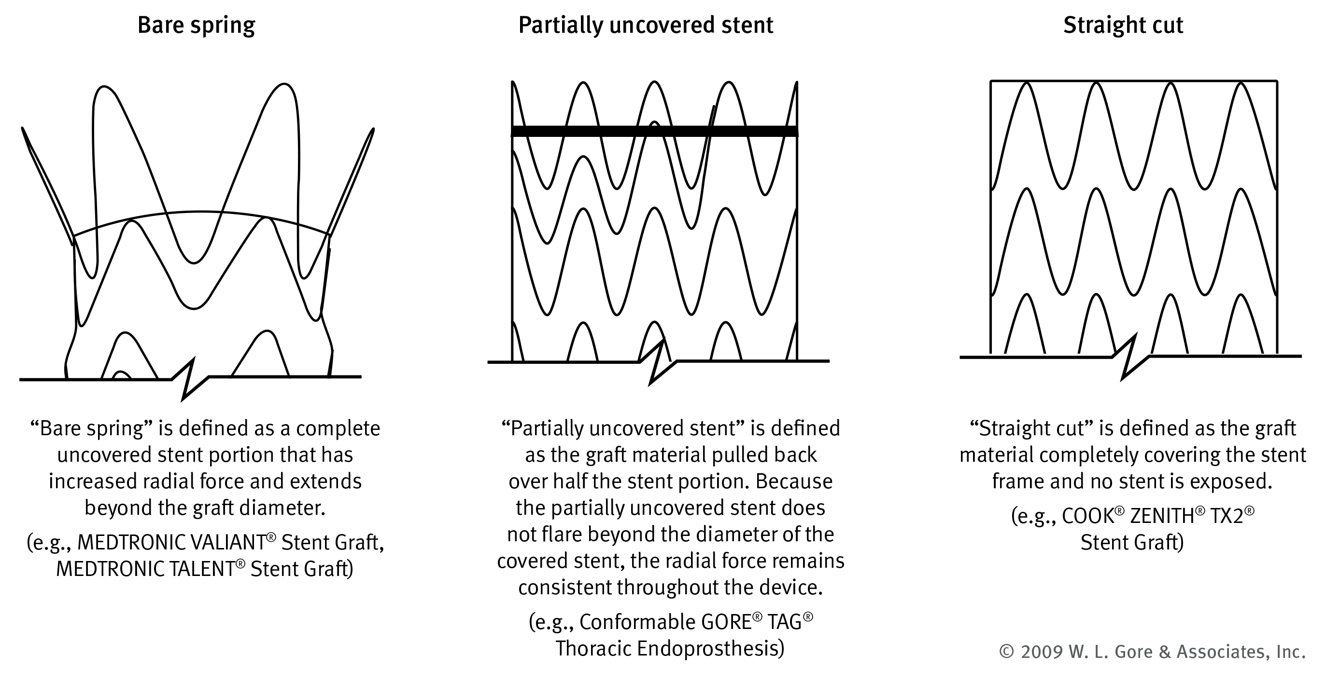
Thoracic stent graft designs
COOK®, TX2®, and ZENITH® are trademarks of COOK® Medical, Inc. TALENT® and VALIANT® are trademarks of Medtronic, Inc.

Slide 15
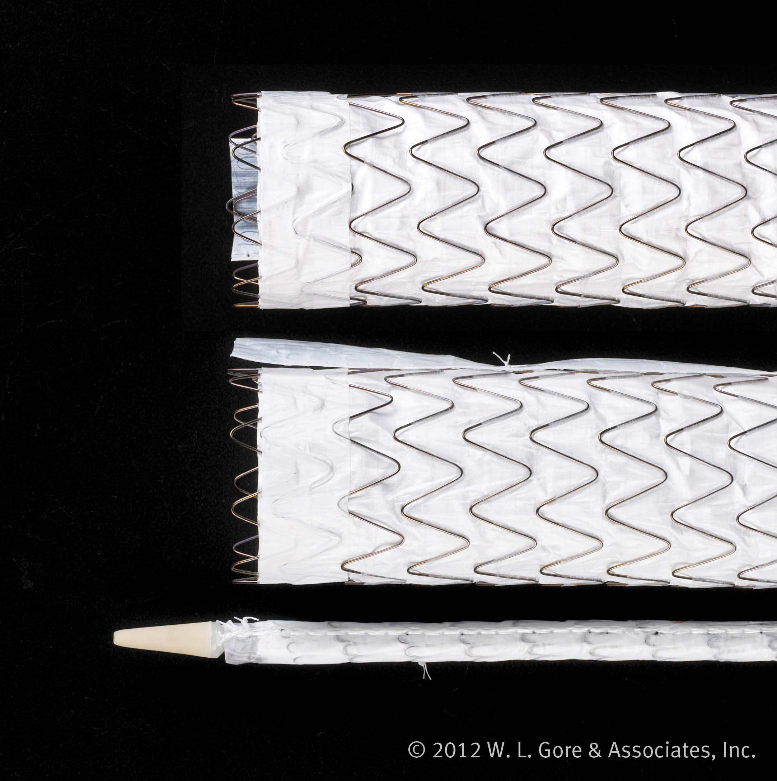
Partially uncovered stents
Partially uncovered stents are designed to allow the maximum seal zone on the inner curve with no compromise to aortic blood flow or compromise to seal
Conformable design helps achieve better graft contact in curved segment of the aorta minimizing the risk of Type I endoleak
Covering an arch vessel with the partially uncovered stent may prevent blood flow to that vessel

Slide 16
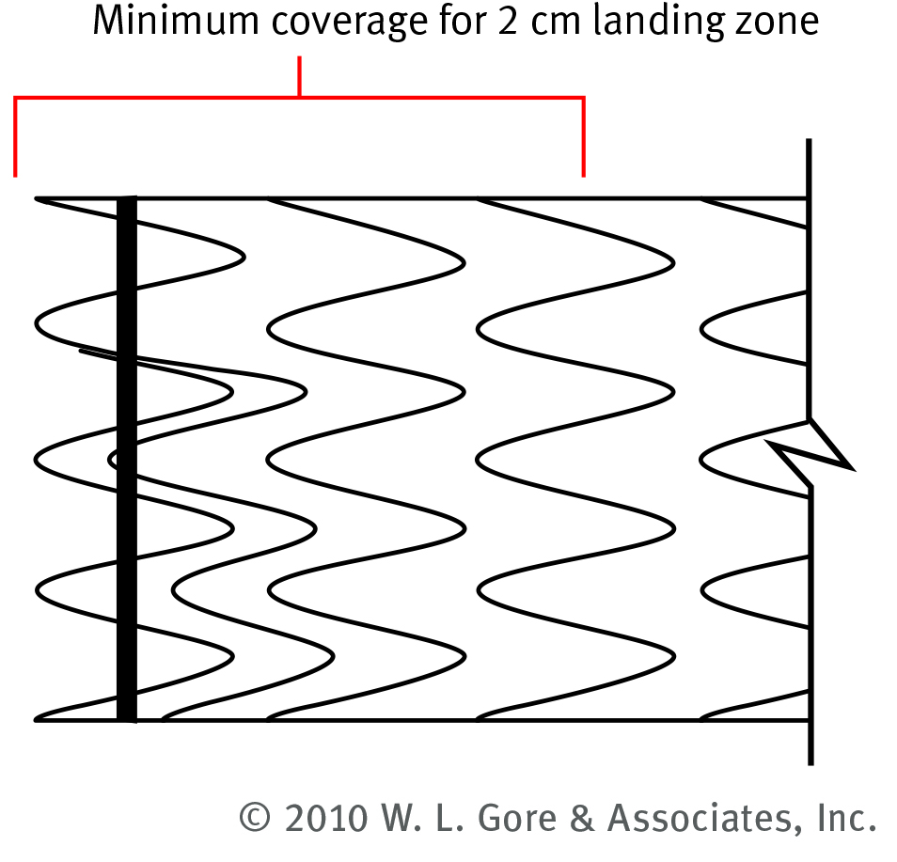
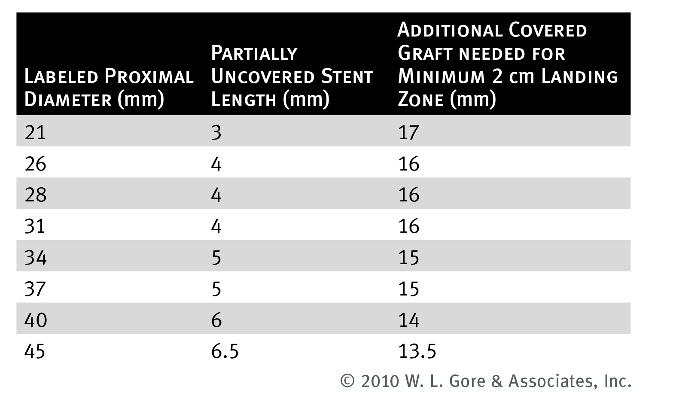
Partially uncovered stents
Partially uncovered stents are included in minimum 2 cm proximal landing zone due to enhanced conformability.

Slide 17
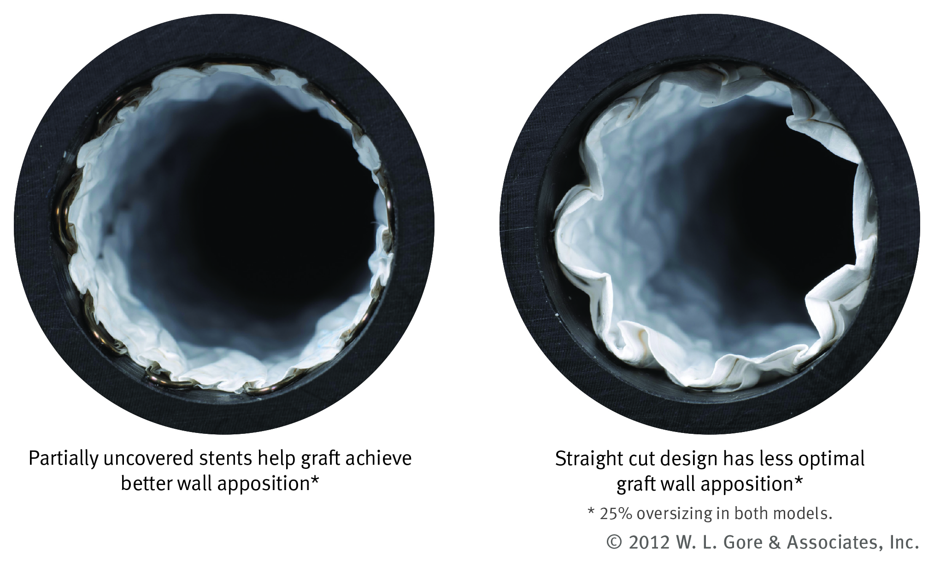
Partially uncovered stents
Designed for 360° aortic wall apposition in angulated anatomy reducing the need for proximal extensions.

Slide 18
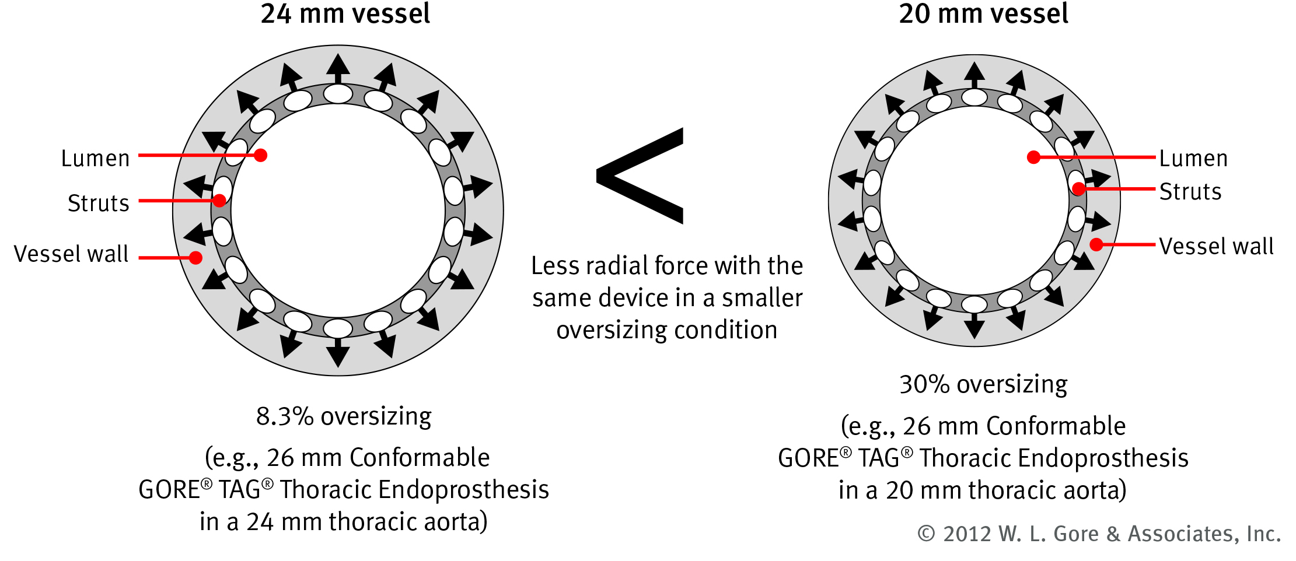
What is radial force?
Radial force is the force exerted by the device (stent) when compressed to a smaller diameter than nominal (i.e., manufactured diameter)
This is typically accomplished when the device is oversized (i.e., device is larger than vessel)
Radial force is NOT constant through treatment range. Increased oversizing has larger associated radial force. This applies to all self-expanding stents.

Slide 19
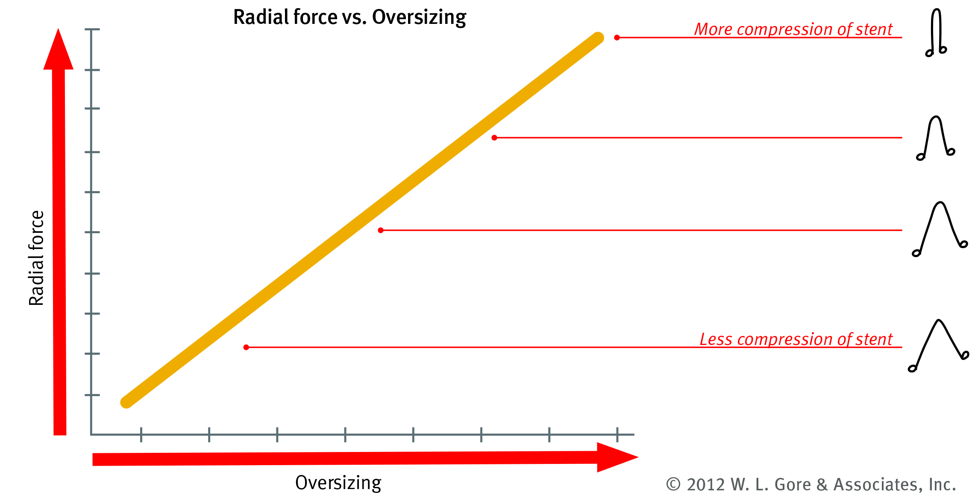
What is radial force?
Radial force differs through treatment range. More oversizing has increased radial force. This applies to all self-expanding stents.

Slide 20
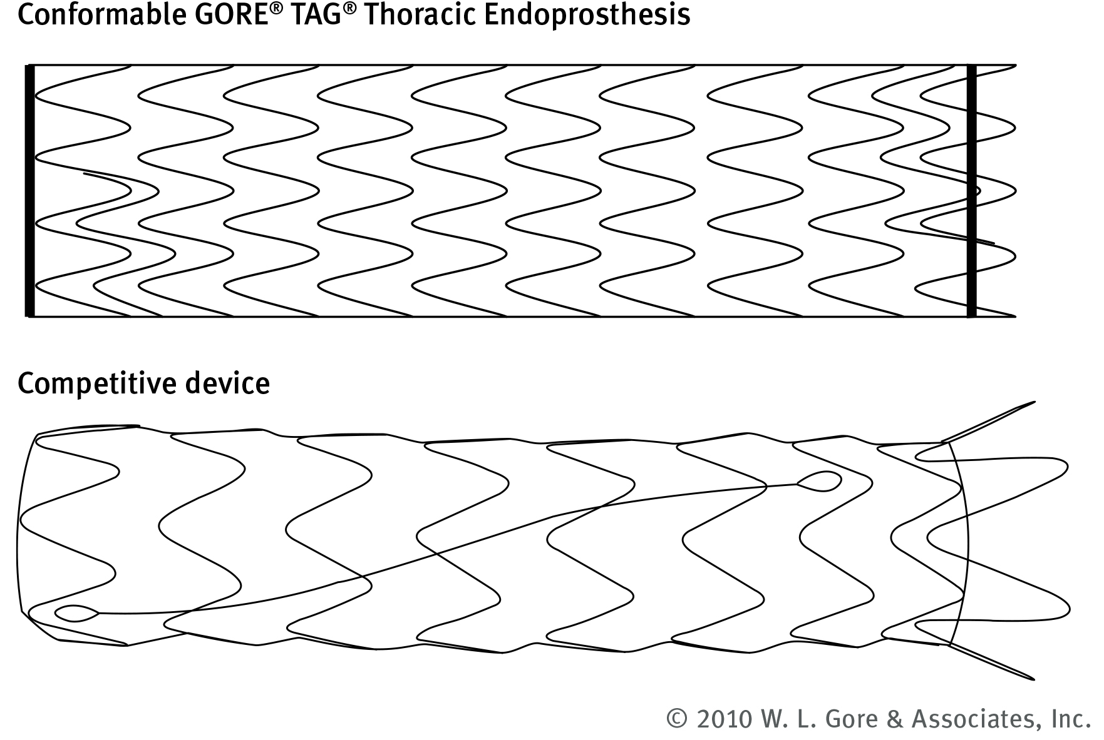
Consistent radial force
Consistent radial force throughout the device is achieved along the entire length
Competitive devices have increased radial force and point load due to flared orientation of bare springs

Slide 21
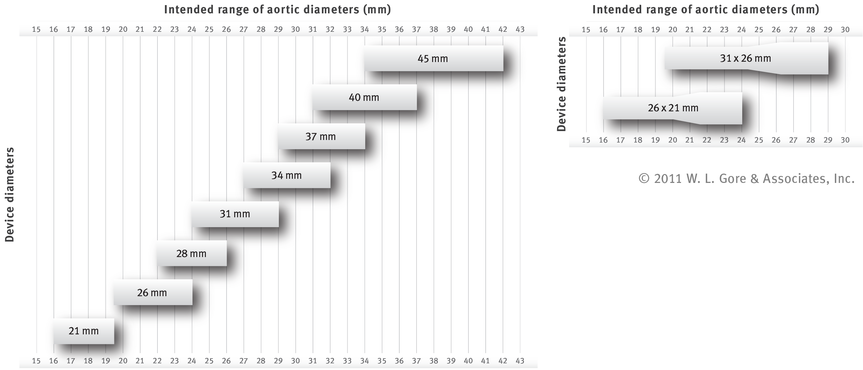
Expanded sizing to meet wide range of patient anatomies
The Conformable GORE® TAG® Thoracic Endoprosthesis is the only thoracic endograft engineered to perform in 6–33% oversizing conditions
Allows physicians to choose the optimal radial force to fit patient anatomy and etiology
Tapered devices further expand treatment options with the Conformable GORE® TAG® Device

Slide 22
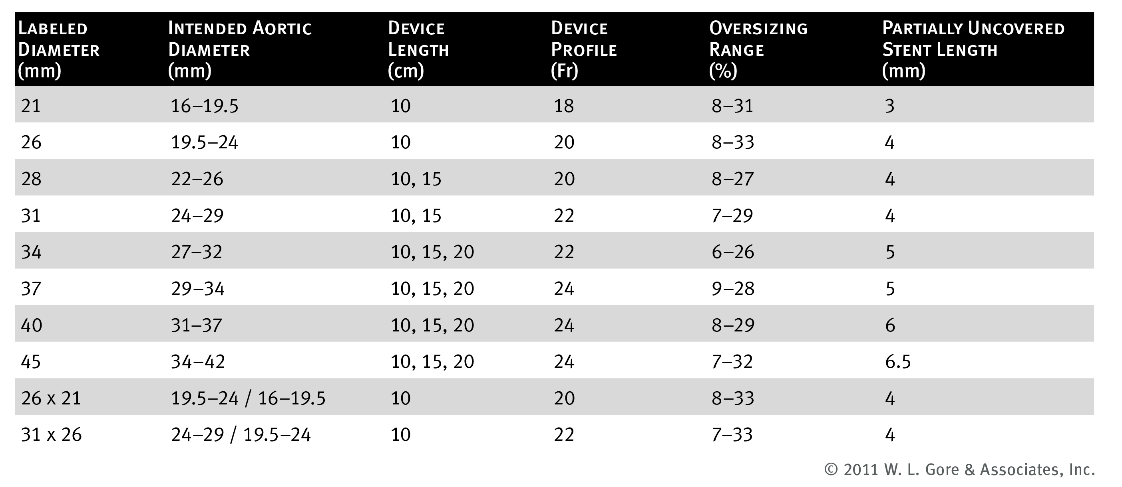
Expanded sizing and oversizing windows
Same sizing chart for Type B dissections as for isolated lesions
If there are two or three device options per IFU for a given aortic diameter, the physician can choose which device will be optimal for the patient’s anatomy

Slide 23
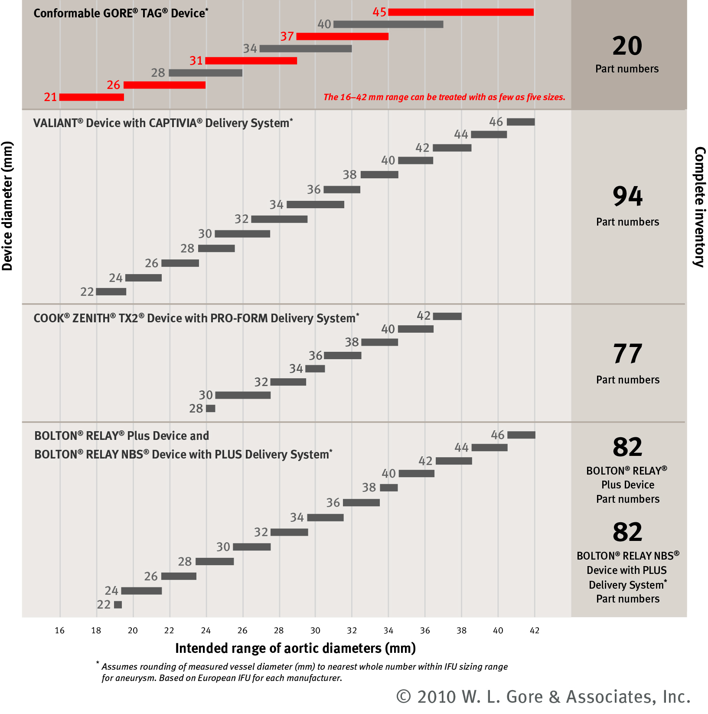
The only thoracic endograft engineered to
perform in 6–33% oversizing conditions
The 16–42 mm range can be treated with as few as five sizes
A unique 6–33% oversizing window also allows physicians
to choose the optimal radial force to fit patient anatomy
and etiology
RELAY AND NBS are trademarks of Bolton Medical. COOK®, TX2®, and ZENITH® are trademarks of COOK® Medical, Inc. CAPTIVA®,and VALIANT® are trademarks of Medtronic, Inc.
GORE®, TAG® and designs are trademarks of W. L. Gore & Associates

Slide 24
Approved for Type B dissection

Slide 25
Clinical studies
Gore’s Dissection Clinical Study History
TAG 04-01 — Complex Pathology Study
ADSORB (TAG 05-04) — European Dissection Study
TAG 08-01 — Conformable GORE® TAG® Device Dissection Study

Slide 26
TAG 04-01 — Complex Pathology Study
This three arm study was designed to evaluate the use of the GORE® TAG® Device in the treatment of complex thoracic pathologies including ruptured thoracic aortic aneurysms, traumatic transections, and acute complicated Type B dissections
19 subjects enrolled in the dissection arm of this study
Acute = diagnosis within 14 days of symptom onset
Complicated = rupture, malperfusion, uncontrollable hypertension, uncontrollable pain, or impending rupture
Primary Endpoint
Composite of death and total paraplegia in subjects at 30 days post-treatment compared with literature-based results from open surgical repair
Outcomes
Dissection arm resulted in half the combined mortality and paraplegia rates as compared to surgical controls in literature (16% vs. 32% respectively)
Favorable aortic remodeling was observed with true lumen expansion, false lumen thrombosis, and reduction in overall aortic diameters

Slide 27
ADSORB (TAG 05-04) — European Dissection Study
Acute Dissection treatment with Stent graft OR Best medical therapy
Randomized European study comparing endoluminal stent grafting and best medical therapy (BMT) to BMT alone in the treatment of acute uncomplicated Type B aortic dissections
This study was evaluating the GORE® TAG® Device, not the
Conformable GORE® TAG® Device
61 subjects enrolled in this study
30 stent graft and BMT
31 BMT alone
Primary endpoint
The incidence of one or more of the following events:
Incomplete or no false lumen thrombosis at 1-year post‑randomization
Aortic dilatation at 1-year post-randomization
Aortic rupture (descending thoracic aorta or abdominal aorta)
Through the 1-year follow-up visit

Slide 28
ADSORB (TAG 05-04) — European Dissection Study
Outcomes
The 1-year primary endpoint favored the stent graft plus BMT over the BMT alone group
ADSORB results confirmed the findings of the INSTEAD trial that endovascular treatment of Type B dissection results in expansion of the true lumen and a reduction in the false lumen. The ADSORB study has demonstrated that this can be performed effectively in the acute phase of dissection.

Slide 29
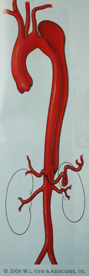
TAG 08-01 —
Conformable GORE® TAG® Device Dissection Study
This single arm study was designed to evaluate the use of the Conformable GORE® TAG® Device in the treatment of acute complicated Type B dissections
50 subjects enrolled in this study
Acute = diagnosis within 14 days of symptom onset
Complicated = rupture and / or malperfusion only
Primary endpoint
All-cause mortality incidence through 30 days post-treatment as compared to an established performance goal
Performance goal based on literature (including TAG 04-01 data) and SVS compiled data from physician sponsored IDE studies
Outcomes
The 30 day all-cause mortality rate was acceptable (met the performance goal)
Favorable aortic remodeling was observed with true lumen expansion, false lumen thrombosis, and reduction in false lumen diameters

Slide 30
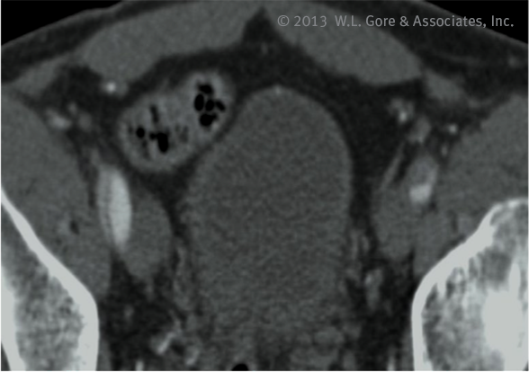
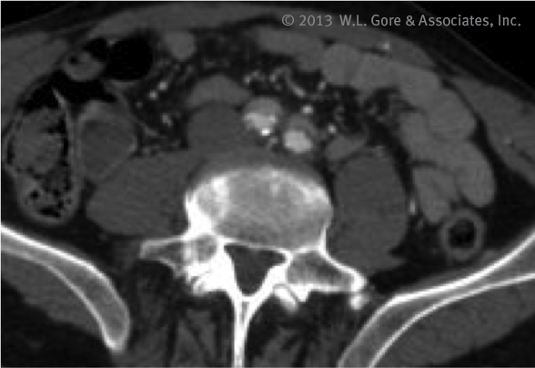
Treatment considerations — Access
Access vessels may be dissected, so consider non‑dissected side for access if appropriate
Ensure vessels are of appropriate size for sheath advancement; access vessels in dissection patients may be more prone to damage
Atraumatic wires / catheters should be used when traversing the aorta. Wires and catheters can cause retrograde dissections upon advancement, so extreme caution is needed.
Ensure guidewire is only in true lumen and does not pass from the true to false lumen through septal tears; angiography and / or IVUS may aid in this determination

Slide 31
Treatment considerations — Deployment
Acute Type B dissections
If two devices are required, deploy proximal device first
Distal deployment first could cause inadvertent pressurization of the false lumen and may result in retrograde Type A dissection

Slide 32
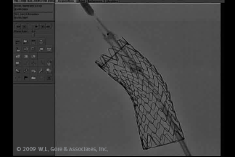
Treatment considerations — Ballooning
Care should be taken when ballooning in patients with a history of aortic dissection
Ballooning should only be completed when necessary such as treatment of an endoleak
Over inflation of the balloon in dissection patients could lead to aortic damage including retrograde dissection and damage to the septum
When ballooning in dissection patients, balloon the proximal landing zone first and then overlapped areas (if appropriate). Do not balloon the distal neck of dissections. Inadvertent pressurization of the false lumen may result in retrograde dissection or damage to the septum.
Ballooning native vessel could lead to vessel damage, rupture, or death

Slide 33
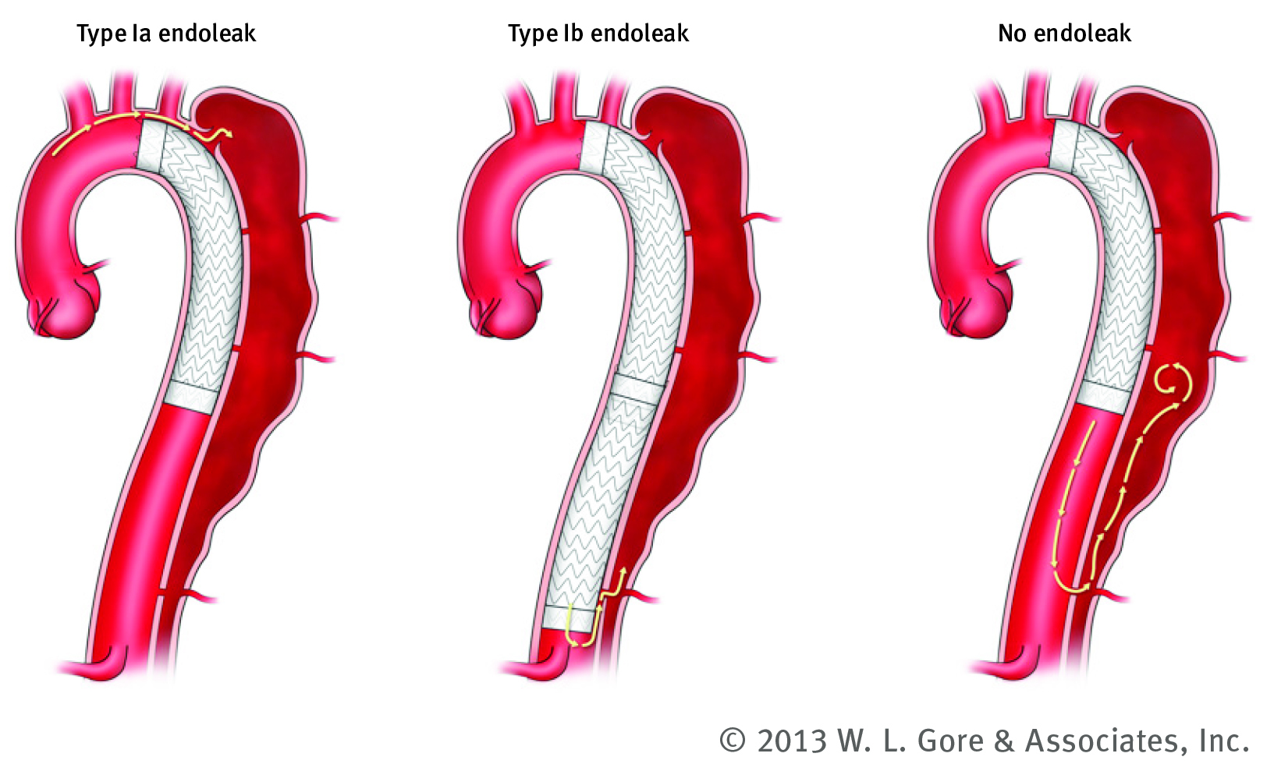
Endoleaks definitions for dissections

Slide 34
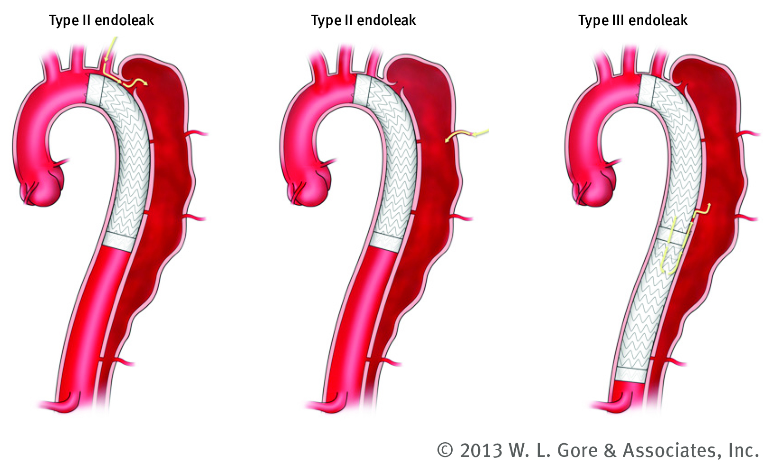
Endoleaks definitions for dissections

Slide 35
Features and benefits

Slide 36
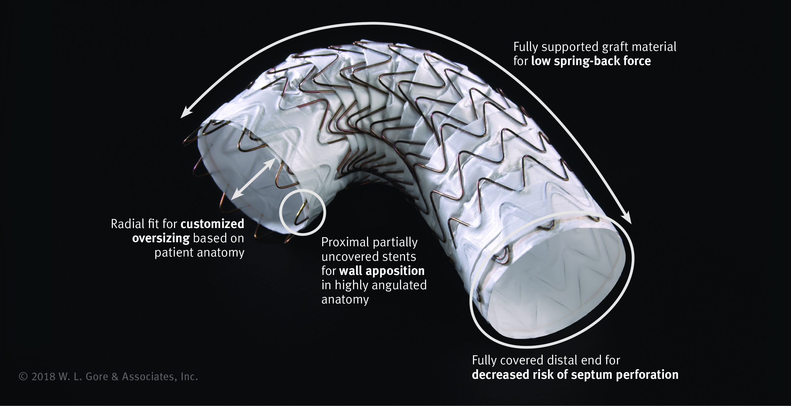
Conformable GORE® TAG® Device is
conformability without compromise

Slide 37
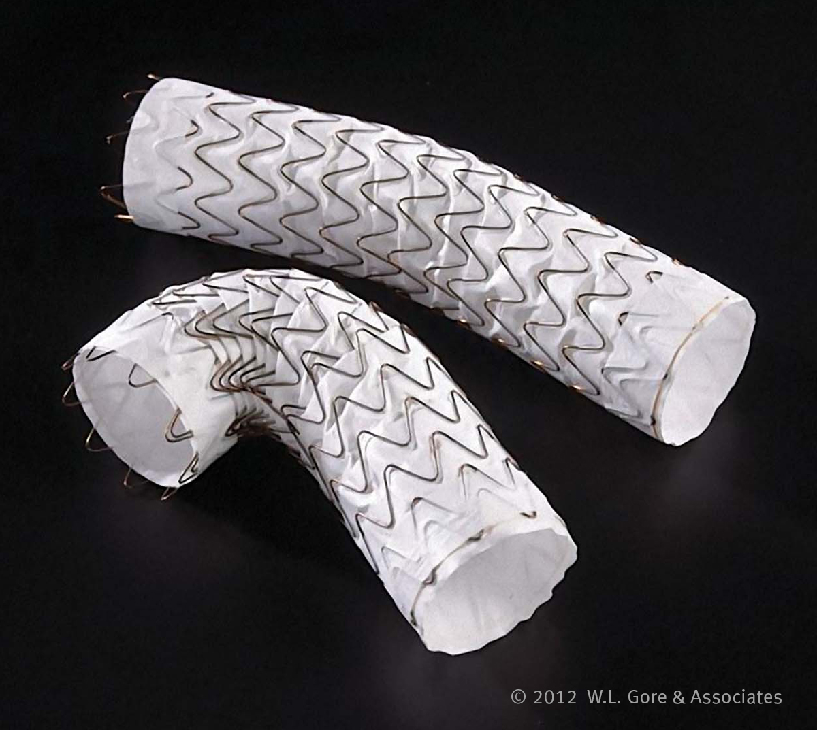
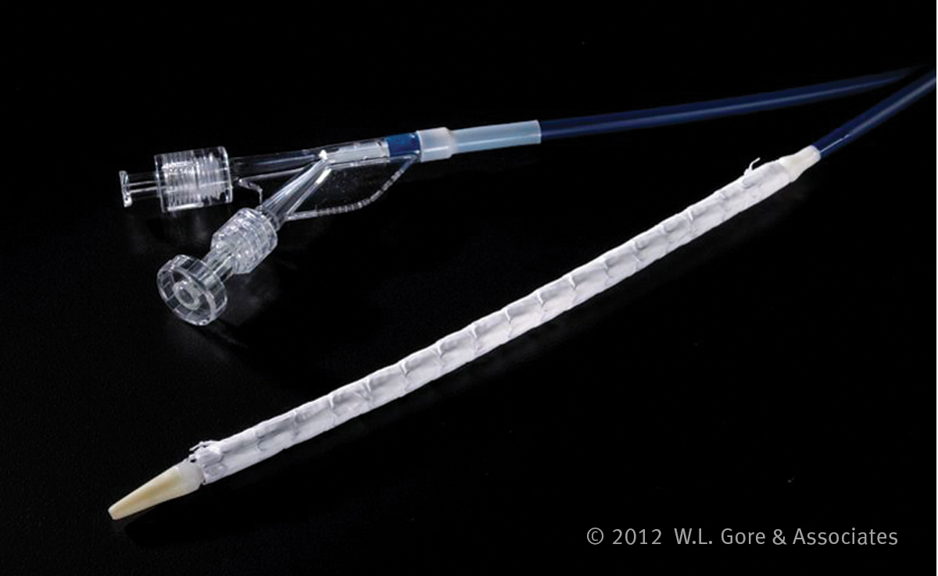
Conformable GORE® TAG® Device is
conformability without compromise
Proven compression resistance
No reports of compression with more than 110,000 devices distributed worldwide*
Increased wire diameter optimizes radial force to resist compression in high flow aortas
Nine apex stent pattern further distributes point load and contributes to long-term durability in maximum oversizing conditions
Unique sutureless design and stent graft construction facilitates consistent conformability throughout the device for uniform arch support
Flexible delivery system tracks in challenging anatomy
Soft leading catheter tip for navigation through tortuous anatomy
Easy one-step deployment
* W. L. Gore & Associates, Inc. GORE® TAG® Thoracic Endoprosthesis Annual Clinical Update.
Flagstaff, AZ: W. L. Gore & Associates, Inc; 2016. AS0089-EN3.

Slide 38
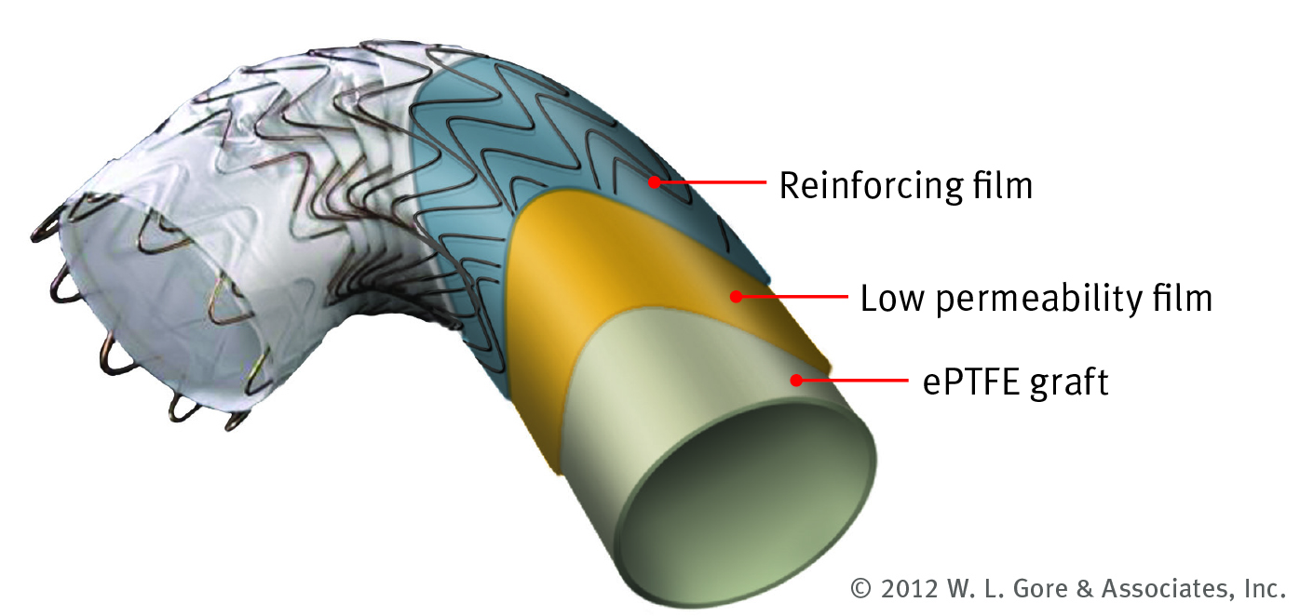
Conformable GORE® TAG® Device is
conformability without compromise
Able to treat more patients
Small diameter and tapered devices offer a large treatment range
A unique 6–33% oversizing window also allows physicians to choose the optimal radial force to fit patient anatomy and etiology
Larger device oversizing windows engineered, tested, and proven to accommodate differences in proximal and distal landing zone diameters
Leverages more than 40 years of experience with ePTFE and a reliable platform with proven clinical durability and strength
Low permeability with abrasion-resistant properties
Optimizes graft and film layers to maximize durability and conformability

Slide 39
Time-tested success
For more than 20 years, the GORE® TAG® Device family has demonstrated impressive success in both clinical studies and real-world commercial use.
More than 125,000 devices distributed worldwide
For more than two decades, we have worked alongside physicians in the evolution of the GORE® TAG® Device family. Our collaboration has resulted in the distribution of more than 125,000 devices, for the treatment of more than 73,500 patients worldwide.*
Proven clinical results
The GORE® TAG® Device family is supported by more than 20 years of clinical experience.
Most studied thoracic endograft available
With the first clinical implant occurring in 1998, the GORE® TAG® Device family has been studied in ten FDA approved clinical studies, one European clinical trial (ADSORB), and one worldwide registry (GREAT).
Forty years of experience with eptfe graft material
Having pioneered ePTFE graft technology more than 40 years ago, we continue to collaborate with physicians and scientists to create a robust and reliable design platform based on proven clinical performance.
* Data on file

Slide 40
Required ancillary devices

Slide 41
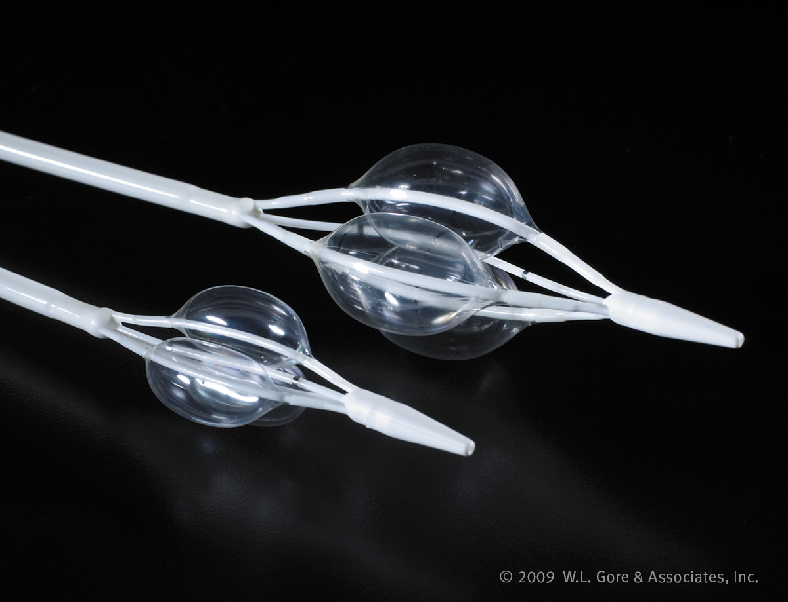
GORE® Tri-Lobe Balloon Catheter
Unique design allows continuous blood flow around the lobes while inflated¹
Decreased hemodynamic pressure on the inflated balloons with approximately 80% of flow for distal perfusion²
Minimizes potential for endoprosthesis movement
and blood pressure spikes post deployment due to significantly reduced hemodynamic pressures¹
Rapid, uniform, and simultaneous inflation and deflation³
Inflation diameters of 16–42 mm
Two sizes:
Small (16–34 mm aortic diameter)
Large (26–42 mm aortic diameter)
1. Gendron M. Simulated Use Testing of Aortic Balloon Catheter for Design Verification –
Final Amendment. Flagstaff, AZ: W. L. Gore & Associates, Inc; 2008. [Work plan]. MD39672.
2. Bloss R, Krall B. Balloon Testing on Pulse Duplicator. Flagstaff, AZ: W. L. Gore & Associates,
Inc; 2009. [Technology notebook]. 1088.
3. Nilson T. Balloon Testing of Aortic Balloon Catheter (ABC) for Design Verification (DV).
Flagstaff, AZ: W. L. Gore & Associates, Inc; 2007. [Work plan]. MD40026.

Slide 42
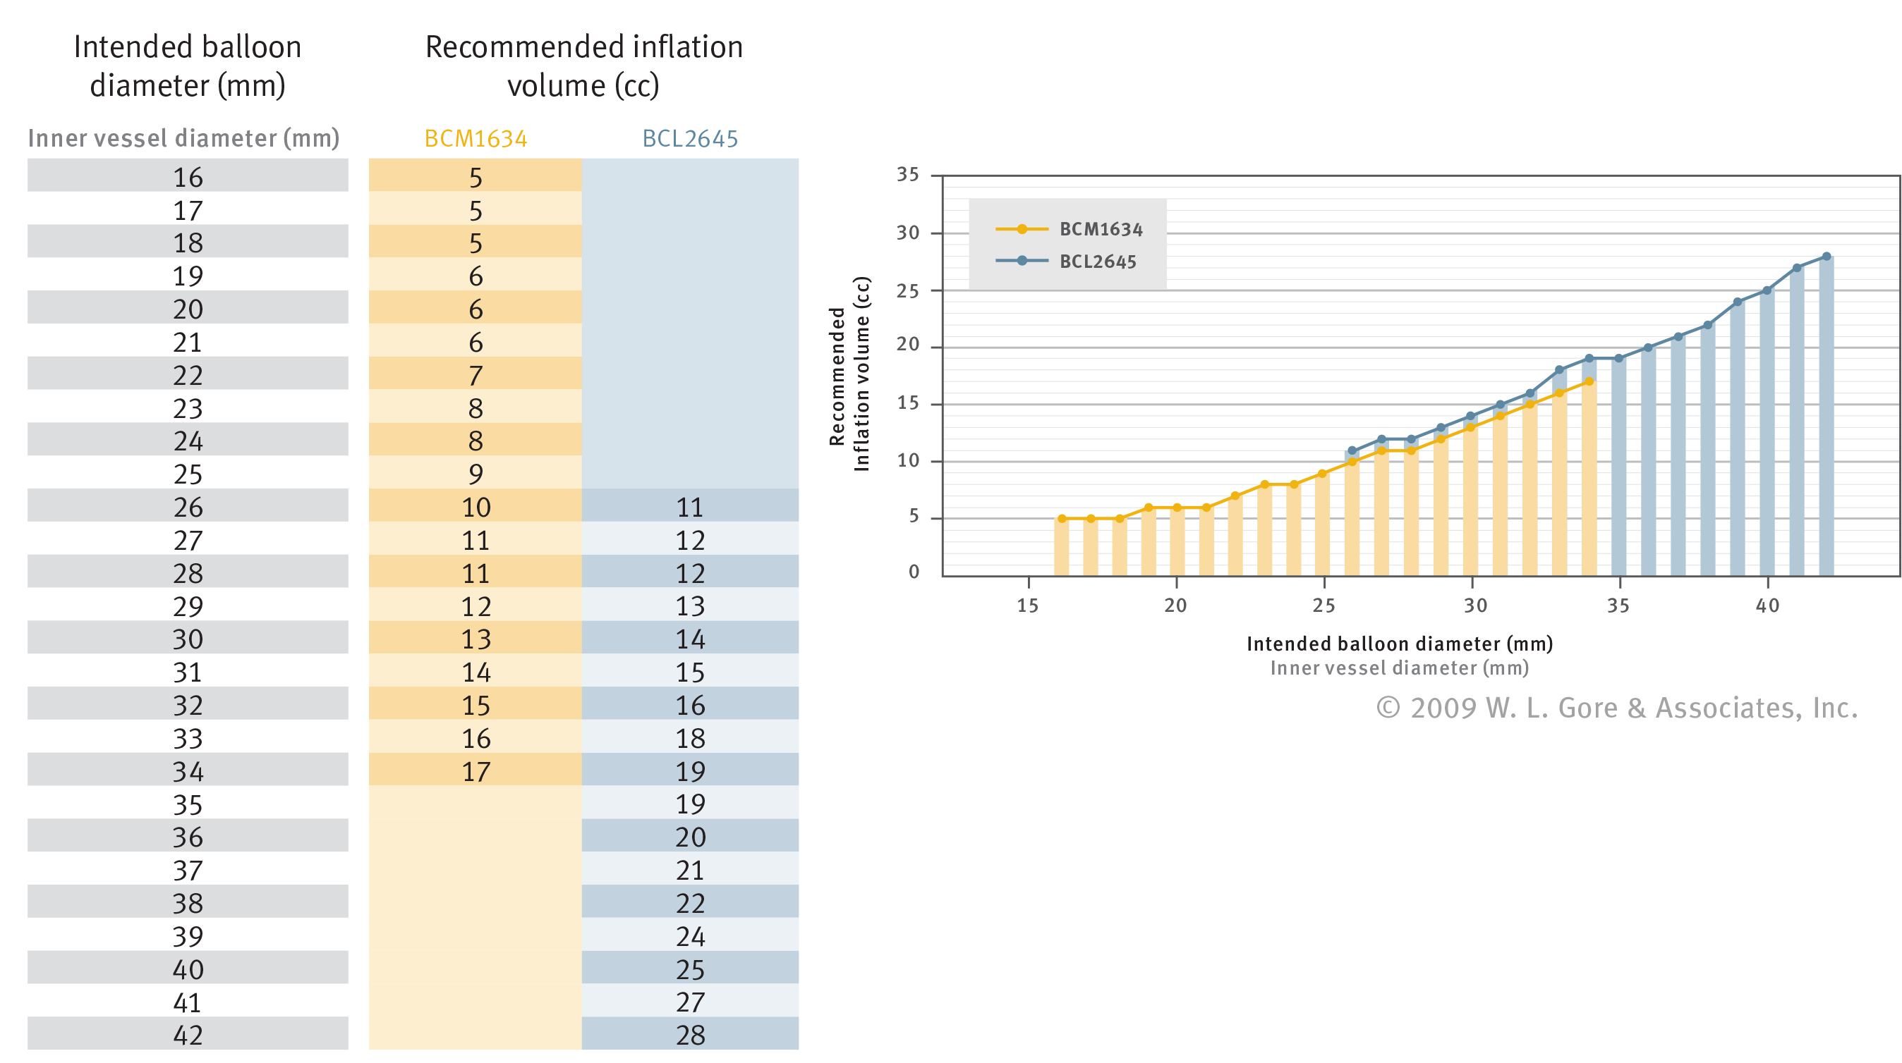
GORE® Tri-Lobe Balloon Catheter
Recommended inflation volume based on aortic diameter

Slide 43
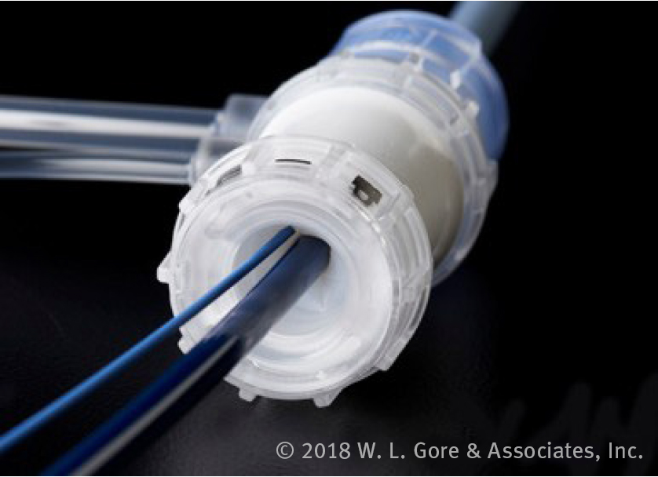
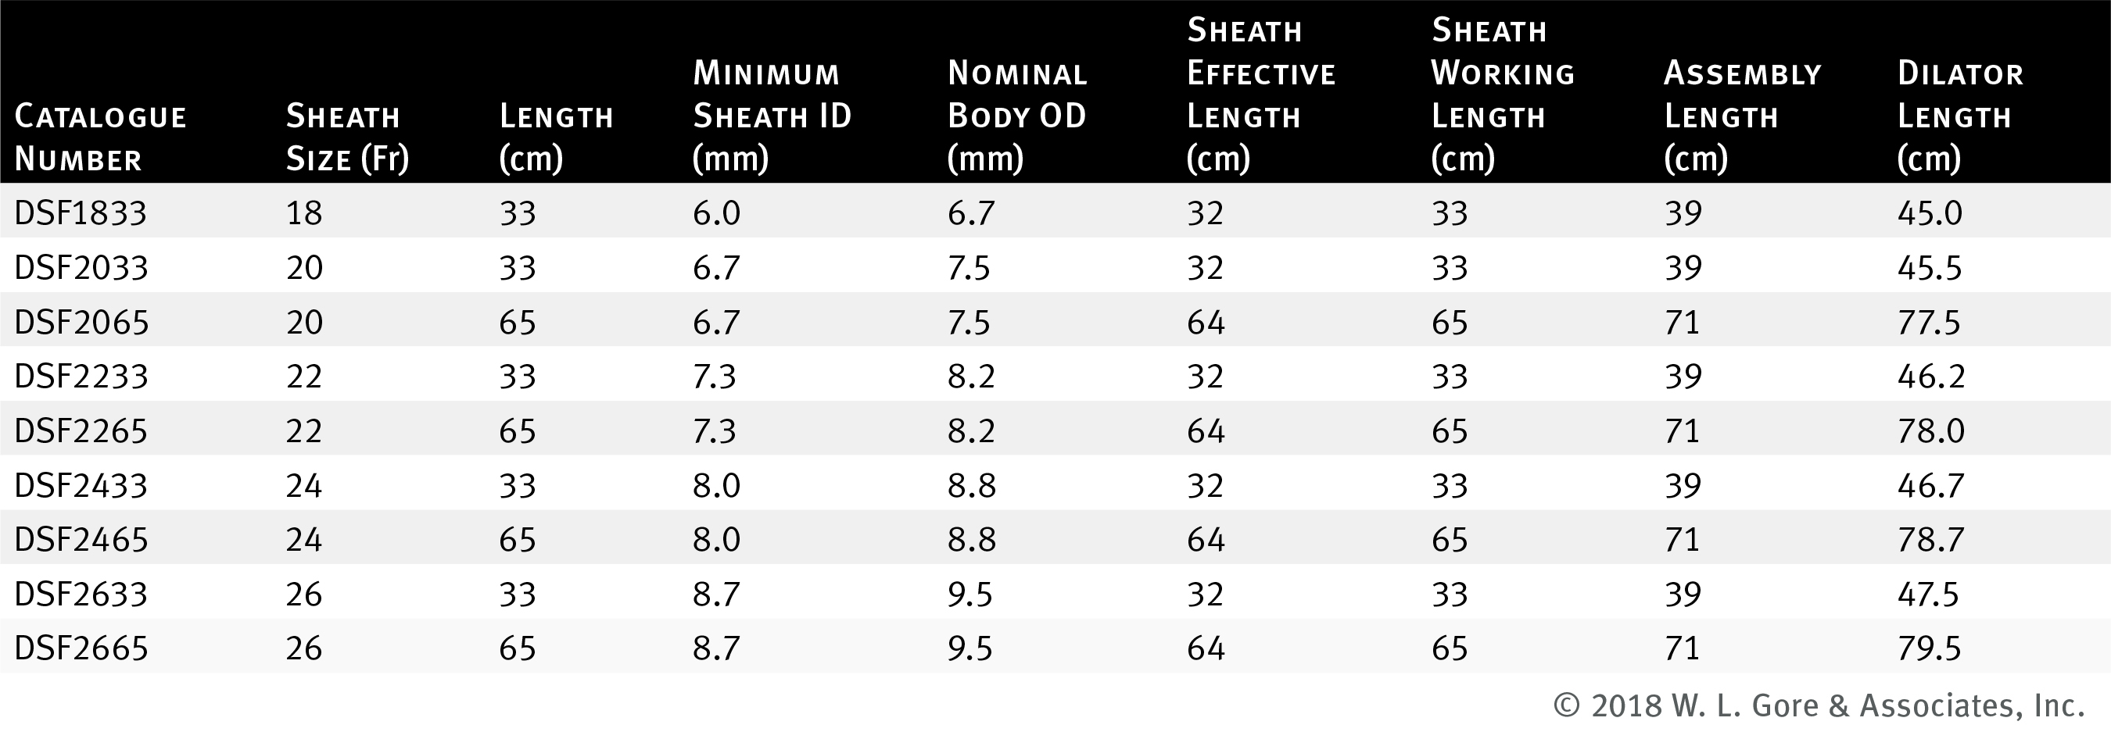
GORE® DrySeal Flex Introducer Sheath
Distinct combination of enhanced flexibility and kink resistance
Optimized profile with decreased sheath wall thickness for larger inner diameter and decreased outer diameter
Smooth guidewire to dilator transition
Locking dilator for ease of insertion
Excellent sheath lubricity

Slide 44
Summary

Slide 45
Summary
Conformable GORE® TAG® Device is the first thoracic stent graft approved in the U.S. to treat aneurysms, transections, and Type B dissections
Engineered to maintain performance and durability of the GORE® TAG® Device
Each device diameter is engineered for the expected anatomic and physiologic environment associated with a given treatment range
Expanded sizes to treat a wide range of thoracic aortas between 16–42 mm
Engineered to be conformable and compression resistant in 6–33% oversizing conditions
Physician can select oversizing based on patient anatomy for optimal conformability and customized radial fit
Off-the-shelf tapered designs provide physicians with more options to match the endograft to the individual patient anatomy

Slide 46
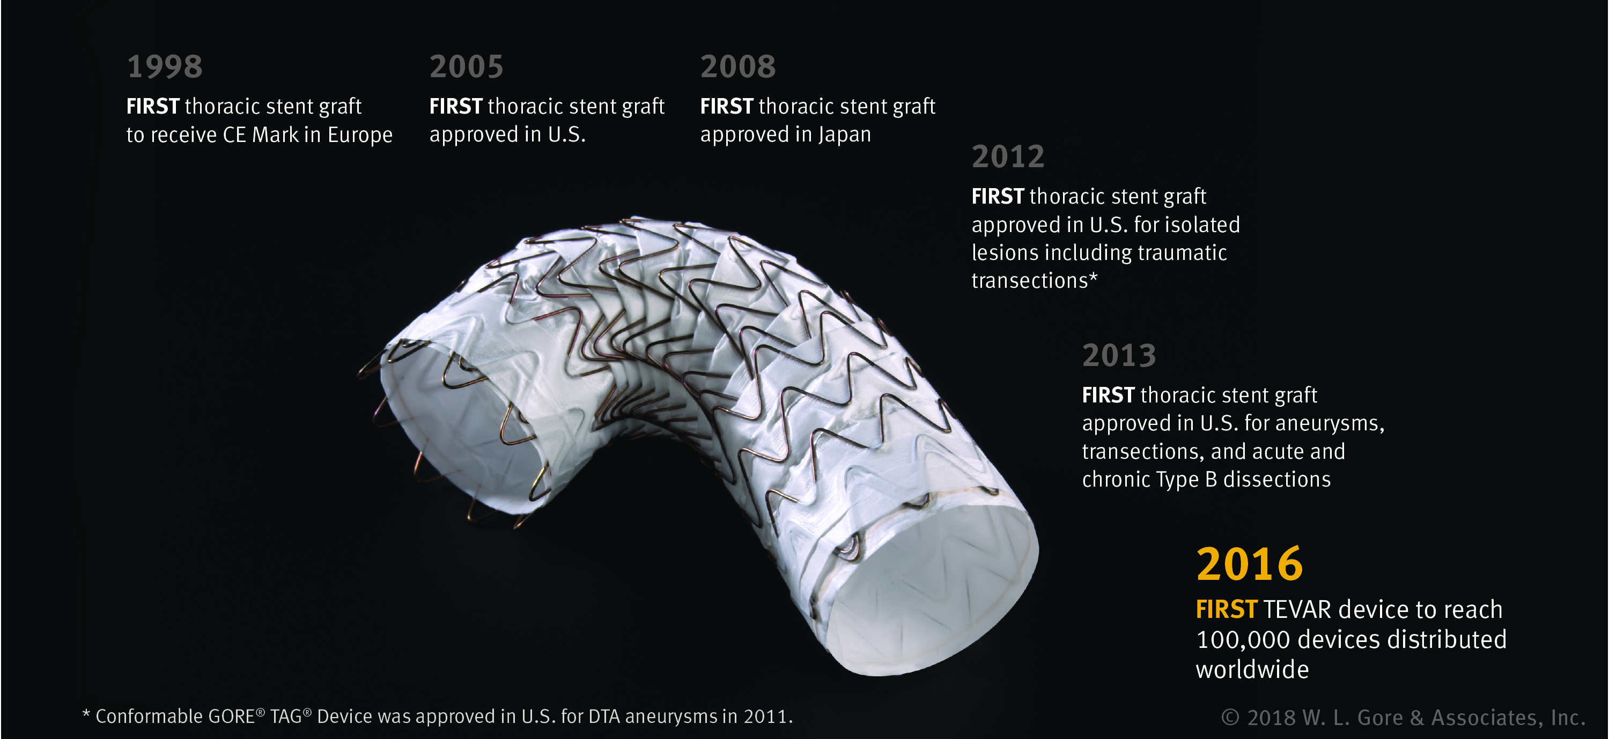
Pioneering TEVAR therapy

Slide 47
